Slide 1
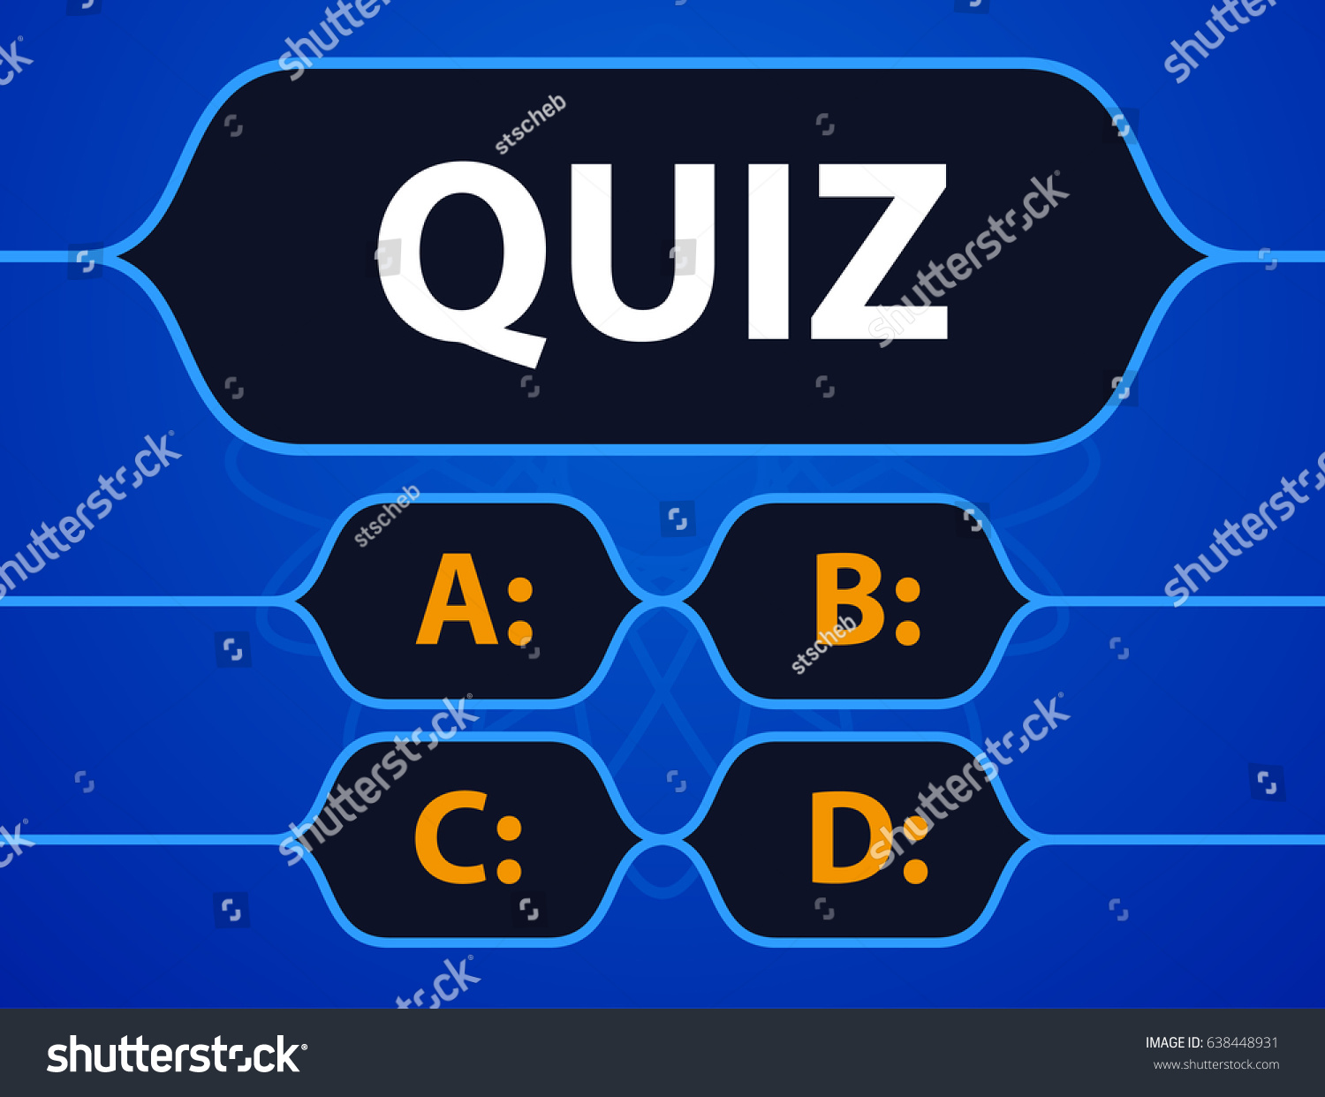

Slide 2
Who invented the quiz?
Oprah Winfrey
Steven Spielberg
George clooney
Richard Daly

Slide 3
Who among the following are the Founders of Social Networking Site: “YOU TUBE” ?
Chris Hughes, Dustin Moskovitz, Eduardo Saverin, Mark Zuckerberg
Larry Page, Sergey Brin
Biz Stone, Evan Williams, Noah Glass, Jack Dorsey
Jawed Karim, Chad Hurley, Steve Chen

Slide 4
In computers, what is the function of Kernel?
Holding the chip in place
Communication between hardware and software components
Maintaining Computer File System
Maintaining Software configuration

Slide 5
In which year Microsoft was founded ?
1970
1974
1975
1976

Slide 6
In Data base ,properties of any entity are represented by its
Setting
Tuples
Attributes
Degree

Slide 7
Which one is the current fastest supercomputer in india
Aaditya
SAGA-220
SahasraT
HP Apollo 6000

Slide 8
Which of the following devices translates hostnames into IP addresses?
DNS Server
Hub
DHCP Server
Firewall

Slide 9
which is incorrect variable name in C
Id_No
ID_NO
IdNo
Id No

Slide 10
Who programmed the 1st computer game ‘space war!’ in 1962 ?
Steave Russell
Konard Zuse
Alan Emtage
Tim Berners-Lee

Slide 11
Who first developed QWERTY keyboard used in computers and phones:
Raphael Finkel
Wim Ebbinkhuijsen
Shafi Goldwasser
Chirstopher Latham Sholes

Slide 12
Which of the below is not an iPhone 4 feature ?
4G
Front facing camera
HD recording
Multitasking

Slide 13
Which mobile company first introduced the Emoji internationally on their mobile Devices
Samsung
Blackberry
Motorola
Apple

Slide 14
UART stands for____________?
Universal asynchronous receiver transmitter.
Universal asynchronous receiver transistor.
Universal asynchronous resistor transmitter.
Universal asynchronous resistor transistor.

Slide 15
The stack is nothing but a set of_________?
Reserved ROM address space.
Reserved RAM address space
Reserved input /output address space
none of the above

Slide 16
EEPROM stands for_________ ?
Electrically Erasable Programmable Read Only Memory
Electronic Erasable Programmable Read Only Memory
Easily Erasable Programmable Read Only Memory
Easily Erasable Programmable Read Only Memory

Slide 17
Who designed the first electronics computer ENIAC ?
Von Neumann
Joseph M Jacquard
J. P. Eckert and J. W. Mauchly
All of above

Slide 18
Fifth generation computer is also known as:
Knowledge information processing system
Very large scale integration
Both of above
None of above

Slide 19
Micro Controller can be used to make
Computer
washing machine
Calculators
All of the Above

Slide 20
The memory which is programmed at the time it is manufactured?
ROM
RAM
PROM
EPROM

Slide 21
The programs which are as permanent as hardware and stored in ROM is known as_________?
Hardware
Software
Firmware
ROM ware

Slide 22
Which of the following memories must be refreshed many times per second?
Static RAM
Dynamic RAM
EPROM
ROM

Slide 23
What do you call the translator which takes assembly language program as input & produce machine language code as output?
Compiler
Interpreter
Debugger
Assembler

Slide 24
Memory is made up of_______?
Set of wires
Set of circuits
Large number of cells
All of these

Slide 25
Who is the CEO and president of AMD (Advanced Micro Devices)?
Jeff Bezos
Lisa Su
Shantanu Narayen
Tim Cook

Slide 26
Who is the president and CEO of HCL technologies ?
Vijay K Thadana
C Vijayakumar
G V Prasad
Rajeev Suri

Slide 27
Who is the CEO of HP (Hewlett packard) enterprises ?
John A Kaneb
Meg Whitman
Richard B Handler
James Dimon

Slide 28
Who is the CEO of Quick Heal technology?
Indra Nooyi
Dr.Kailash Katkar
Mark Thompson
Satya Nadella

Slide 29
Hard disk is coated in both side with
Magnetic metallic oxide
Optical metallic oxide
Carbon layer
All of the above

Slide 30
The name of the Indian Boy promoting the Artificial Intelligence in the world?
Ananya Sharma
Chanakya Madurai
Tanmay Bakshi
Rahul Khan

Slide 31
Name of the first Human Robot get the citizenship from Government of Saudi Arabia
Joseph
Marry
Swikly
Sophia

Slide 32
What is the full form of YAHOO ?
YET ADAPTIVE HIERARCHICAL OFFICE ORACLE
YET ANOTHER HIERARCHICAL ORIENTATION ORGANISATION
YET ACTIVE HEWLETT OFFICIOUS ORGANISATION
YET ANOTHER HIERARCHICAL OFFICIOUS ORACLE

Slide 33
What is the full form of GOOGLE ?
GENERAL ORGANISATION OF ORIENTED GLOBAL LANGUAGE OF EXTENSION
GRAPHICS ORIENTATION OF OFFICIOUS GROUP LIVING OF EARTH
GLOBAL ORGANISATION OF ORIENTED GROUP LANGUAGE OF EARTH
GLOBAL ORIENTATION OF ORGANISING GROUP LOCALITY OF EARTH

Slide 34
What is the full form of INTEL ?
INTEGRETED ELECTRICAlS
INTEGRETED ELECTRONICS
INTIGRATION ELECTRICALS
INTERNATIONAL ELECTRONICS

Slide 35
What is the full form of NFC?
NETWORK FILE COLLECTION
NATIVE FUNCTION COLLABORATION
NUMBER FIDELITY CODE
NEAR FIELD COMMUNICATION

Slide 36
What is the full form of RTOS ?
REPEAT TRANSFER OHIO SCALE
REAL TIME OPERATING SYSTEM
REFLECTION TERMINATE OPEN SYSTEM
RADIO THREAD OPERATING SYSTEM

Slide 37
What do you call a single point on a computer screen?
Cell
Element
Pixel
Bit

Slide 38
The first-ever crime-free zone along the international border between India and which county has launched?
Sri Lanka
Bhutan
Myanmar
Bangladesh

Slide 39
Which country cuts off border agreement with India recently?
Myanmar
Indonesia
Pakistan
Iraq

Slide 40
Which country allows the women to participate in All-female marathon ?
Afghanistan
Pakistan
Bangladesh
Saudi Arabia

Slide 41
______ is the host country of 23rd edition of the World Congress on Information Technology (WCIT-2019).
Mexico
Brazil
Canada
Armenia

Slide 42
Which University ranks top in 2018 World University Rankings?
Harvard University
University of Oxford
University of Cambridge
Stanford University

Slide 43
What is the Latest Version of JAVA JDK?
1.8.0
9.0.1
9.0.4
9.0.6

Slide 44
Storage capacity of magnetic disk depends on
tracks per inch of surface
bits per inch of tracks
disk pack in disk surface
All of above

Slide 45
To produce high quality graphics (hardcopy) in color, you would want to use a/n
RGB monitor
Plotter
Ink-jet printer
Laser printer

Slide 46
What is mean by Liveware?
People who work with computer
People who work with processor
People who work with memory
People who work with programming

Slide 47
What is Beta Test?
Trial test of computer before the production
Trial test of computer or software before the commercial lunch
Trial test of computer component
Trial test of computer after the commercial lunch

Slide 48
First Indian cinema released through internet is______
vivah
hum aapke hai koun
veer zara
border

Slide 49
What is Scareware?
Anti virus software
Virus software
Fake anti virus software
fake virus software

Slide 50
When was the first smart phone launched?
1990
1991
1992
1993

Slide 51
What is a blog?
Technical Theorey
Online journals and diaries
Agenda of Research
Bibilography

